Slide 1
Le Cult of Josh
presents

Slide 2
LUNAR-MORTIS
A moon technician awakes from stasis in a hellish nightmare on Moonbase Omega. His colleagues dead. Or worse. The moon? Covered with astronaut zombies. Secure and uncover the secrets on the lonely moon. Reclaim Moonbase Omega one room at a time.

Slide 3
Story
The Player finds themself on an abandoned moon-base, that has been overrun with a zombie infestation.
After surviving for a few days, the Player will receive a communication from a passing starship.
They will work toward locating and clearing the landing bay.
All goes wrong.
The Player must decide what to sacrifice to escape the moon base.

Slide 4
Story Implementation
The Game will implement heavy environmental story telling cues.
Discoverable recordings/logs will be littered around the game world.
Story will be revealed in an abstract way, to encourage fan theories, and the development of online communities.

Slide 5
Graphics
The game will have a 3D low-poly art style so that it can run smoothly on a variety of different hardware and for ease of development.
Mobile support and optimisation is not currently an objective or priority but due to the low-cost rendering, it could easily be implemented in future.
The graphics should be simple enough to be performant but contain enough detail so that immersion is not sacrificed.

Slide 6
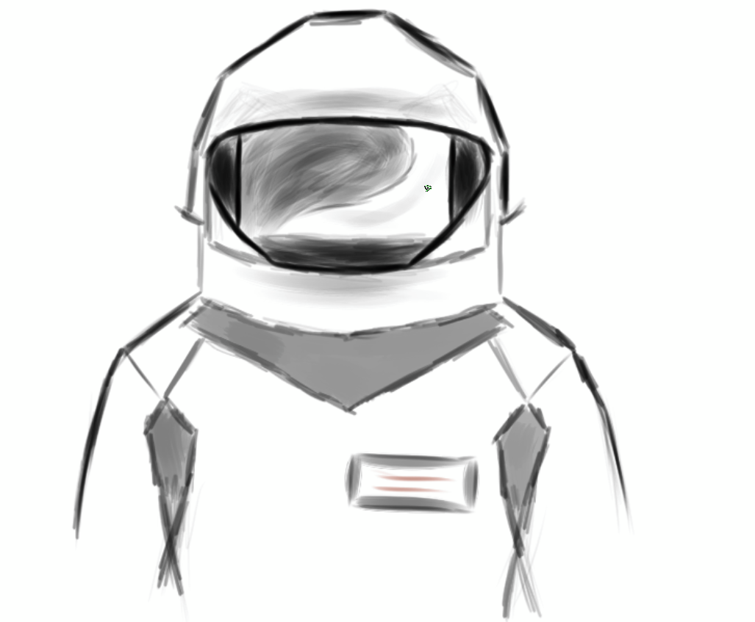
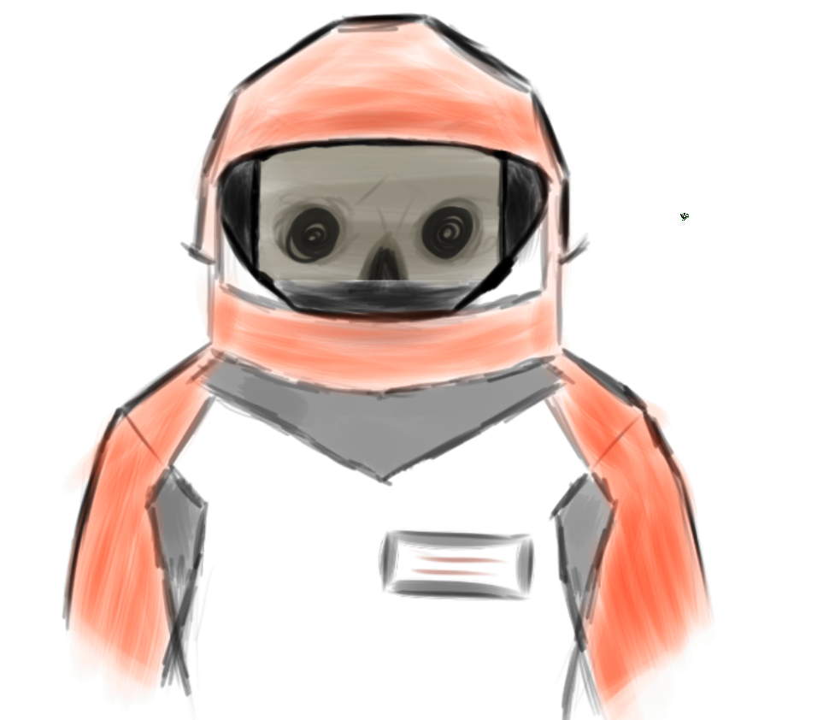
Concept Art

Slide 7
Game Mechanics

Slide 8
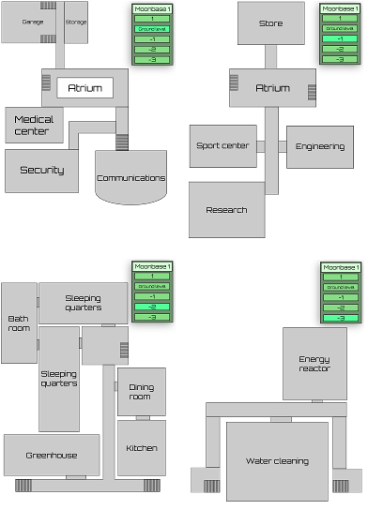
Map Mechanics
Randomly Generated modular Moon base (Rogue-Lite)
Random room layout
Unique types of rooms with different functionality
Armory, Medical Room, Generator room, Security room, many more
Rooms require:
Oxygen to allow you to stay in the room indefinitely. Obtained from oxygen tanks or oxygen rooms
Power to allow you to use the rooms functionality and have the lights on. Obtained from batteries or generator rooms

Slide 9
Territory Mechanic
The player at any time can open a map and see all known rooms
Rooms will be marked as safe, Dangerous or unknown
Push through the map, slowly securing the Moon base
Random zombie hordes can come, break in and damage rooms and retake over safe territory
The player can seal doors to stop the horde from advancing, but they could still be there when the door is unsealed.

Slide 10
AI mechanics
Zombies
Can lose limbs either from spawn or from precise damage
Zombies with missing limbs behave and attack differently
Zombies with missing arms will try bite
Those with missing legs will crawl
Droids
Can be found randomly or in certain rooms
Security rooms can have security droids
Medical rooms can have medical droids
Must be repaired once found

Slide 11
NPC mechanics
NPC's can be found randomly locked inside rooms
The player must complete a side quest for the NPC in order for them to open the door
Once completed, the player will unlock the use of the room as well as the NPC. The NPC can be assigned to work in a powered room in a secure area of the base.

Slide 12
Immersion
Some immersion-based graphical components will include:
Blood/gore
Loss of limbs
Particle systems to show game mechanics such as oxygen escaping, smoke or sparks
Dynamic lighting that can change intensity and hue based on different game events such as blackouts
To be consistent with the horror-theme and enhance immersion, the game will include graphical techniques that can induce feelings like fear or creepiness – this can be accomplished using techniques such as implementing limited visibility (sparse lighting + fog) and unfamiliar looking terrain/room textures which can be procedurally generated.

Slide 13
Market Research

Slide 14



Platforms

Slide 15
Steam
Peaked at 26 million concurrent users
120 million monthly users
$100 USD fee per product
30% of game sales go to Steam
Biggest gaming platform

Slide 16
PlayStation - PSN
Holds 46% of the console market
102 million monthly users
No publish price, however dev kit is $2500
30% of game sales go to PlayStation

Slide 17
Xbox - Live
Holds 25% of the console market
100 million monthly users
Game pass is around 18 million users
$19 for individuals, 99$ for corporations to publish
30% of game sales go to Xbox
On PC 12% goes to Xbox, inline with competitors

Slide 18

Epic Games – Honourable mention
Newcomer to the PC store world
100 million users
12% goes to epic games
Currently in closed beta for publishing

Slide 19
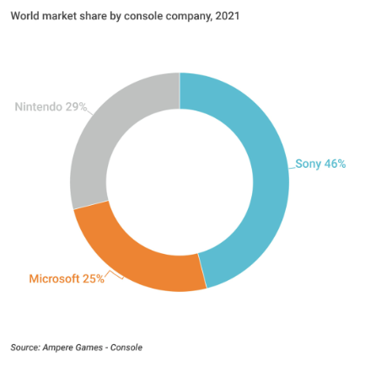

Slide 20
Game Comparison

Slide 21

Dead Space 1
Released 14th October 2008
Cost approximately $37 million to develop and market
Sold around 1.4 million copies as of May 2009
Sold at around $50 on Xbox360, PS3 and Steam

Slide 22
Target Audience

Slide 23

Our target audience
Horror
Survival
Zombie
Top Down
Horror Survival games are very popular and can do well when combined with a unique experience.

Slide 24


The funnel
342 Million
50 Million
5 Million
1.8 Million

Slide 25
The Price
£14.99 at launch
Potentially £26.9 Million gross profit

Slide 26
Age ratings

Slide 27






PEGI – Europe (Except Germany)
This rating is applied once the depiction of violence (or sexual activity)
reaches a stage that looks the same as would be expected in real life.
The use of bad language in games with a PEGI 16 rating can be more
extreme, while the use of tobacco, alcohol or illegal drugs can also be
present.

Slide 28


USK – Germany
The category may include games with considerable violence, abusive
language and some nudity.

Slide 29


ESRB – North America
Content is generally suitable for ages 17 and up. May contain
Intense violence, blood and gore, sexual content and/or strong
language.

Slide 30


Australian Classification
R 18+ material is restricted to adults as it contains content that is
considered high in impact for viewers. This includes content that may
be offensive to sections of the adult community. A person may be
asked for proof of their age before purchasing, hiring or viewing R 18+
films and computer games at a retail store or cinema.

Slide 31

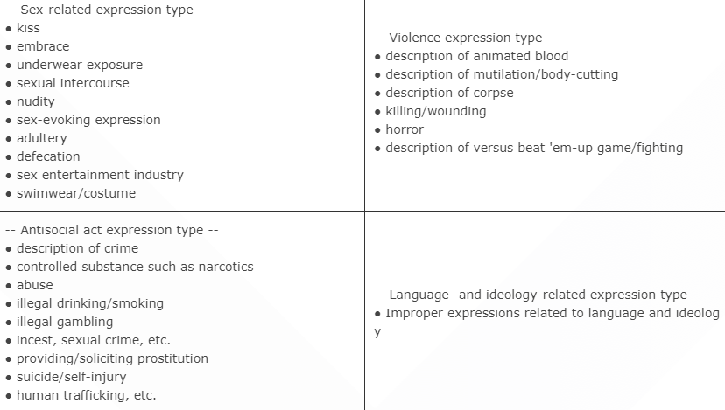

CERO - Japan
For 18-year-olds and above only. Expression and content only suitable
to 18-year-olds and above are included in the game.

Slide 32


GRAC – South Korea
The content and motif of the game have representations of obscenity,
violence, speculation, etc. that would be harmful to children under 18
(direct and concrete graphical representation of sexuality, violence,
improper language(expletives), reproduction of gambling spirit (existence
of arousing of passion of excessive use of gaming money, or dependence
on one's luck, but no real gaining or loss of one's asset).

Slide 33

Why Is There No China?
China has very strict restrictions when it comes to gaming.
Game assets would need to be changed due to Chinese laws.
There is also time restrictions we must implement and keep track of.

Slide 34
Thank you for listening
Any questions?

Slide 35
References
https://www.statista.com/statistics/272639/number-of-registered-accounts-of-playstation-network/
https://www.ampereanalysis.com/insight/console-market-reaches-new-heights-with-growth-to-60-billion#:~:
text=Console%20services%20spending%20as%20a,to%20reach%2021%25%20in%202022
https://partners.playstation.net/
https://www.xbox.com/en-us/publish
https://store.epicgames.com/en-US/publish
https://pegi.info/what-do-the-labels-mean
https://usk.de/en/home/age-classification-for-games-and-apps/
https://www.esrb.org/ratings-guide/
https://www.cero.gr.jp/en/publics/index/17/
https://newsletter.gamediscover.co/p/steam-the-new-wishlists-to-first

